Slide 1
Comparative Technical Analysis: Image Processing vs. Computer Vision
Sub: ITA0512 Computer Vision Done by: K.Vijay Bhaskar Reddy

Slide 2


Defining the Problem Scope
Image Processing
Computer Vision
Primarily concerned with the enhancement, restoration, and transformation of digital images. It focuses on modifying physical properties (pixels, contrast, colors) to improve visual quality without trying to understand image contents.
Aims to give machines human-like perception, enabling them to interpret, analyze, and gain high-level understanding from visual data to produce semantic descriptions of scenes and answer: "What am I looking at?"

Slide 3
Technical Domain Comparison
Technical Aspect | Image Processing (IP) | Computer Vision (CV)
Primary Goal | Modify or enhance an image to improve visual quality. | Interpret, analyze, and understand the semantic content.
Output Type | Modified image (image-to-image). | High-level description or decision (image-to-information).
Problem Scope | Filtering, noise reduction, geometric transformation. | Object recognition, detection, tracking, segmentation.
Level of Abstraction | Low/Mid Level: Pixel and edge operations. | High Level: Object and concept operations.

Slide 4









The Foundational Pipeline
1. Acquisition & IP
2. Feature Extraction
3. CV Interpretation
Acquires raw data and applies Image Processing to clean and prepare the input (e.g., denoise, correct exposure, resize).
Identifies key edges, textures, and regions of interest, bridging low-level pixels to higher-level patterns.
Processes extracted features through Machine Learning models to produce semantic output and decisions.

Slide 5

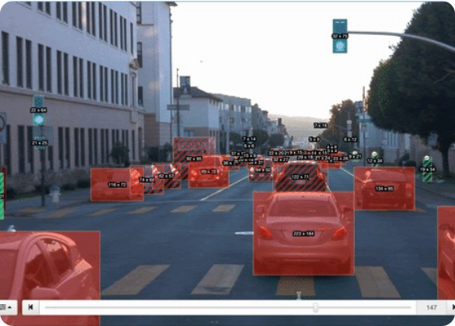
Practical Application: Autonomous Vehicles
Image Processing Task: Takes raw video input, corrects lens distortion, performs deblurring from high-speed motion, and enhances contrast in low-light conditions.
Computer Vision Task: Analyzes video frames to detect and classify pedestrians, lane lines, traffic signs, and vehicles to make real-time driving decisions.

Slide 6









Summary & Key Takeaways
Complementary Roles
Deterministic vs. AI
Strategic Synergy
Image Processing cleans, enhances, and prepares raw visual data, while Computer Vision interprets it to extract high-level semantic meaning.
Image Processing relies on mathematical algorithms, whereas Computer Vision leverages probabilistic Machine Learning and Deep Learning models.
Building effective visual AI systems requires unifying high-fidelity Image Processing inputs with intelligent Computer Vision decision-making.

Slide 7
